Slide 1
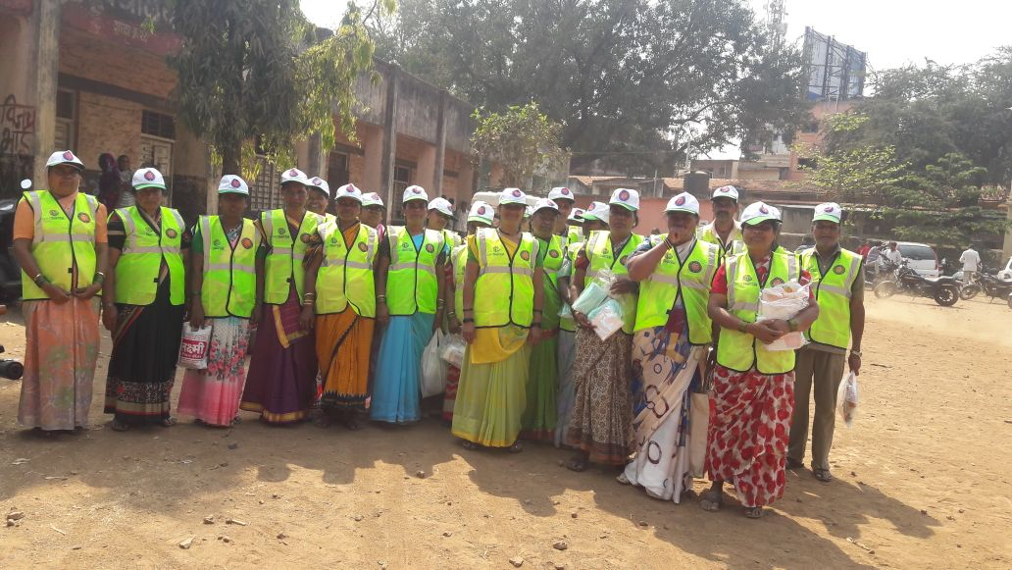
Skill Development Management Application for Safai Karamcharis
A demonstration of SCGJ/SafaiKaramChari app
Notes:
Good Afternoon everyone, we are happy to announce that the Skill Development Management Application for Safai Karamcharis is LIVE! All this started with numbers. If we talk about India then we have around 15L + Safai Karamcharis across the nation. That is when SCGJ and NSKFDC collaborated to uplift the skill capacity of people engaged in waste management activities and trained 5000 candidates in 2017 & 2018 and now with SCGJ training candidates across the country , The need for a digital solution was felt in order to manage, facilitate, conduct the trainings in a better way. We are happy to share that we have been able to deliver this application within the agreed scope.

Slide 2
Executive Summary
When we completed…
When we started…
Project Highlights
Project
Description
Scope
Automated Batch Generation for Training Partner
Data Import Functionality for Training Partner to enter batch details
Automated Report Generation for Training Partners
Generate Credentials for SCGJ to generate user credentials of TP
Single view for all the necessary information for the leadership
Design and develop a digital solution to manage and automate administrative processes in skilling of Safai Karamcharis
10 features were shortlisted to be developed
Deliverables
An easy to use and scalable web application
A user friendly, robust and scalable web application developed on latest technology
Key
Differentiator
Value addition
Agile approach involving evolutionary development, flexible to change requests & promoting continuous improvement
Collaborative effort across cross-functional teams including development, UI and Quality assurance
Daily defect triaging and bug prioritization including implementation of feedback from stakeholders/marketing team
Timelines
Delivered additional scope items in crunch timelines with minimal to zero defect rate
8 Weeks of business analysis, development, testing to ensure quality and timely delivery of product
Extended development support to build new pages and incorporate CRs from SCGJ team
Notes:
8 weeks back when we discussed the problem statement with SCGJ then around 10 most important aspects/challenges faced by SCGJ and its Training Partners were discovered and after 8 weeks of business analysis, development and testing along with constant support from SCGJ has resulted into a digital solution which will not only reduce the re-work that the training partner did for each batch but will also improve the efficiency and productivity of SCGJ by about 70%. This application focuses on making the life of a training partner easier by reducing the amount of effort that was put in for each batch which will automatically improve the productivity and efficiency of SCGJ

Slide 3
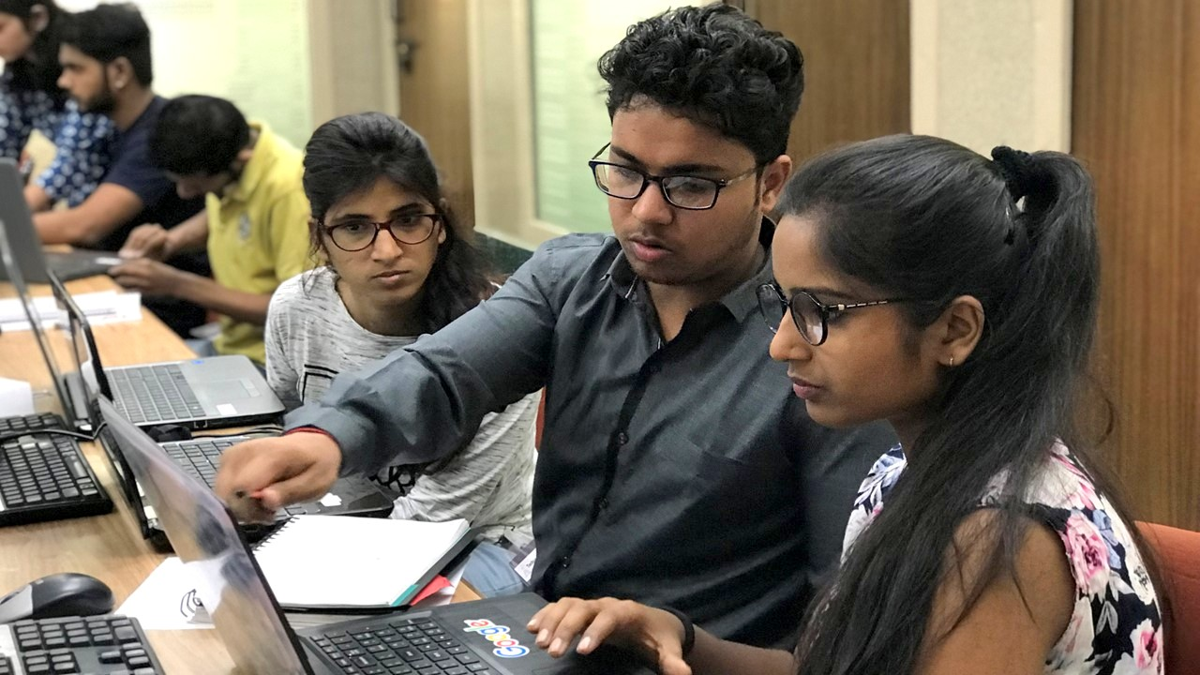
Project Numbers
Quantifying the work
2000
700
Testing and Bug Fixing hours
Development Hours
67
Functionalities
9
Modules
Notes:
If we talk about the application side of things then this application has 9 modules with over 67 different functionalities counting to around 2000 development hours and 700 extra hours of testing and bug fixing . This amount of effort was put into developing this application in order to ensure that the application functions as per the requirements and covers most of the aspects of both the stakeholders

Slide 4








Scope Items
High level Features for SCGJ and Training Partners
Skill Council for Green Jobs
Training Partner
Interactive Dashboard
Automated Batch Generation
View Documents
Master Sheet Import
Generate Credentials
Generate Reports
Update Targets
Upload Documents
Notes:
Connect these functionalities
Left Slide → Utility
Right Slide → Efficiency & Authenticity & Standardisation
Dashboard → As the number of candidates being trained increases more and more effort would go into getting the accurate stats and information, this module will help in that case
View Documents → TP directly uploads the documents and the skill council will be able to see that , Kamal will no longer have to call the training partner to get a document of the previous batch and wait for it. Just write the name of the training partner and it will be done
Generate Credentials → Skill council has full access to give access to the training partner of the application and assign targets and once the target has been allotted an official email from the SCGJ’s side can be sent to them informing them about the credentials and targets for this financial year
Update Targets → If any training partner has completed the target then his/her targets cannot be updated and the updated data will be available on the dashboard of training partner
Training Partner
Automated Batch Generation → Auto Generation of a batch and generation of excel sheet to add data into the system
Master Sheet import → The training partner will no more create different documents, all the information will be available in one single document which will be filled during different phases of training
Generate Reports → Training partner would not have to create any reports now , everything will be done by the system which will increase efficiency and save time
Upload Documents → Upload documents as soon as they are generated which enables the skill council to view those documents
These functionalities will reduce the overall time and re-work that caused inefficiencies and delays

Slide 5
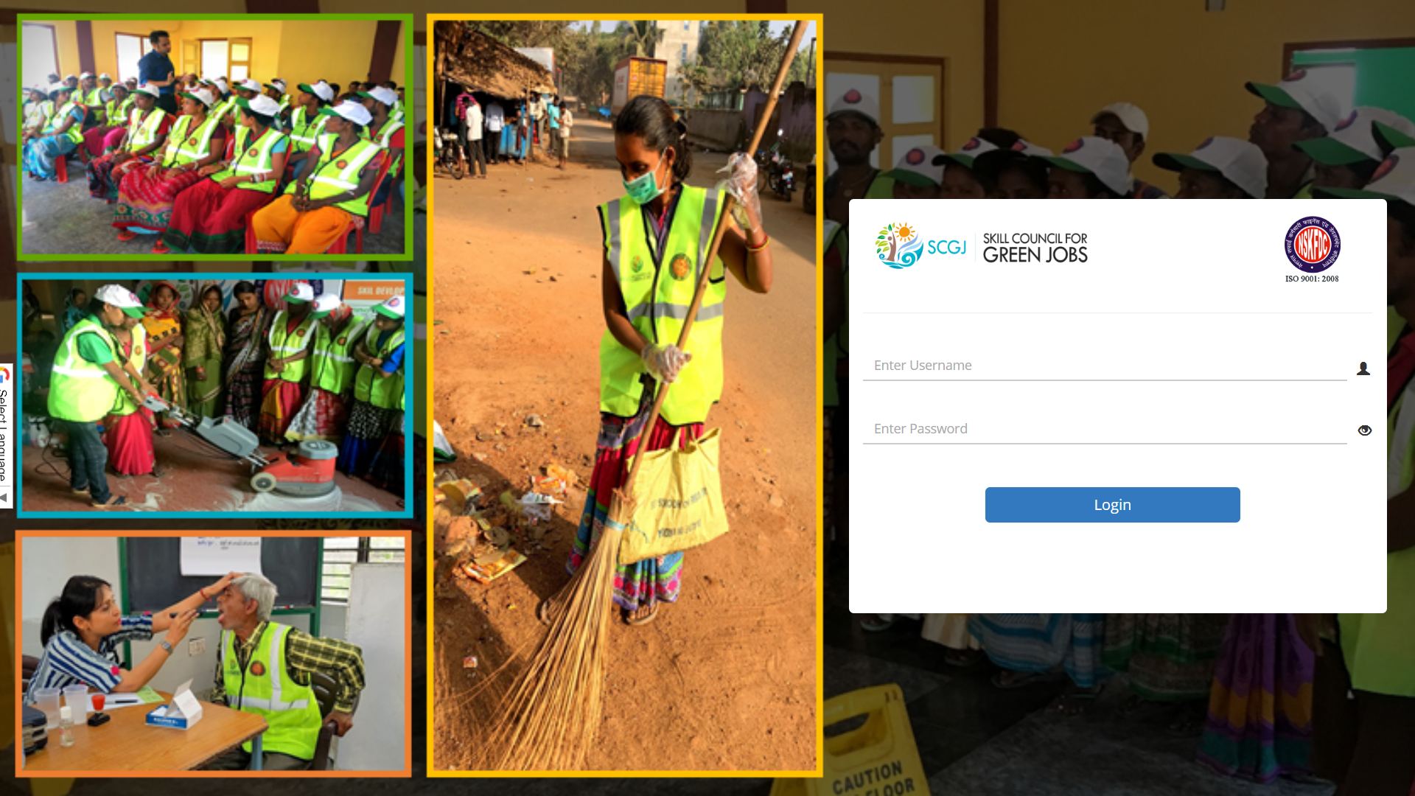
The web application
https://www.scgjsksd.in

Slide 6

www.smaltandberyl.com

Slide 7
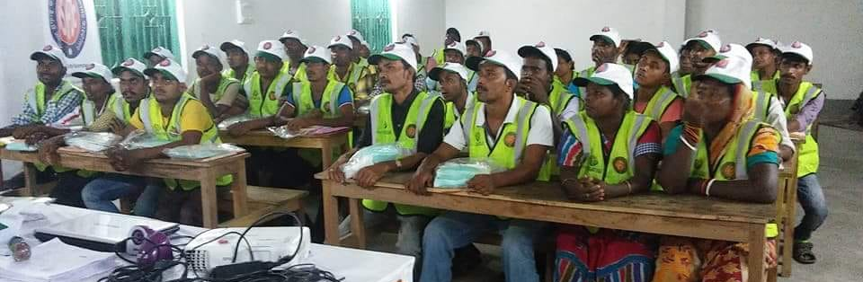
Skill Development Management Application for Safai Karamcharis
A demonstration of SCGJ/SafaiKaramChari application

